Slide 1
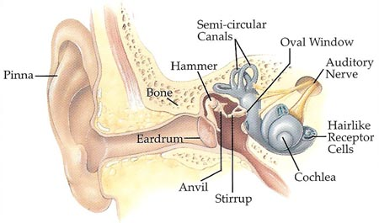
Your Ear….
Your Ear….

Slide 2
?? Cochlea Implant ??
A cochlear implant (CI) is a surgically implanted electronic device that provides a sense of sound to a person who is profoundly deaf or severely hard of hearing.

Slide 3
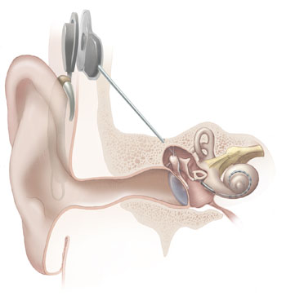
A Cochlea Implant….
It send the messages directly to the brain

Slide 4
Cost Of An Implant….
The total cost per adult cochlear implantation after the first year is around £27,000 !!!!!!!!.
The total cost per adult cochlear implantation projected over the thirty years of expected use is around £44,000.
Costs for childhood implants can be higher due to more intensive rehabilitation.
The total cost per childhood cochlear implantation after the first year is around £30,000.
The total cost per childhood cochlear implantation projected over the thirty years of expected use is £60,000 !!!!!!

Slide 5
What Are The Benefits….
An implant cannot restore hearing to normal but it does give the sensation of sounds. Although at first the sounds are not as the person remembers them, with training they become more natural and meaningful. Implants work particularly well for adults and children who have lost their hearing after acquiring spoken language and for young children who were born deaf.

Slide 6
?? How Does It Work ??
In a healthy ear sound waves are transmitted across the eardrum and through the middle ear to the cochlea (inner ear). Highly specialised cells within the cochlea convert these mechanical vibrations into electrical signals which travel along the auditory nerve to the brain.

Slide 7
Who Is Involved….
People on the team involved in cochlea implants include:
Sound Engineers who develop sensitive sound processors that can be used in the implants. These scientists need a good understanding of sound frequency and amplitude and how vibrations can be changed into electrical signals.
Brain and Cognition scientists research how deaf patients can get the most out of their cochlea implant by understanding how the brain makes sense of sounds.
Ear Surgeons are doctors who have specialised in surgery on the ear. They have to understand how the human ear works and have special skills in attaching electrodes to the auditory nerve.
Speech Therapists support patients with cochlea implants to learn how to speak clearly and at a constant volume.

Slide 8
?? Why Have They Been Developed ??
Cochlea implants have been developed to give those with harsh of hearing a change to hear like us.

Slide 9
?? What are the advantages ??
The advantages are..
You Can Hear Normally
You can live your life
Don’t have to worry about a hearing aid

Slide 10
?? What are the disadvantages ??
Operation could be fatal
Does not always work
Expensive !!!!!!!!!!!!

Slide 11
Views On The Implant…
1st person
Could be fatal, expensive,
2nd person
Brill, works, impressed

Slide 12
?? How Deos It effect the parents ??
They don’t always have to shout
Effects Bank
Improve life

Slide 13
Student Name ………………………………………………… Level ………………………
To get level | You might: | level | Where in your presentation the information is found.
3 | State what a cochlea implant is | 3.0
 | Explain simply why cochlea implants have been developed. | 3.3
 | Identify which scientists will help with the cochlea implant. | 3.7
4 | Describe an advantage of having a cochlea implant. | 4.0
 | Describe a disadvantage of having a cochlea implant. | 4.3
 | Describe simply how the cochlea implant works with the ear | 4.7
5 | Describe two views about having cochlea implants. | 5.0
 | How have cochlea implants affected the parents of deaf children and deaf people. | 5.3
 | Explain how the cochlea implant works with sound waves. | 5.7

